Slide 1
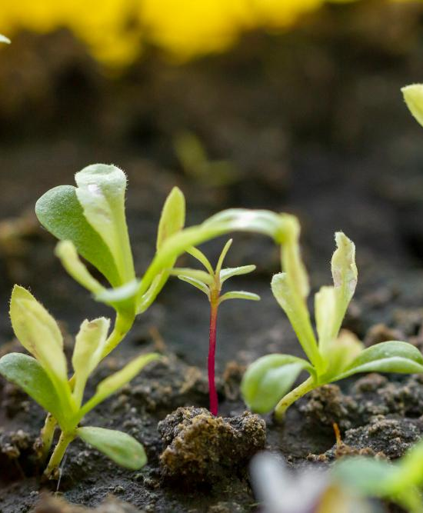
SmartCrop AI-Powerd Crop Recommendation System
Done By:
Aisha Al Majed
Batool Al Hajji
Lateefa Al Obaid
Maha Al Jaafari
Instructor:
Dr. Hala Hamdoun

Slide 2
Table of contents
01
02
03
04
05
Introduction
Methodology
Approach
Problem, Objectives, and Scope
How it works - Recommendation System Overview
Machine Learning Approach
Linking AI in Recommender Systems to Our Project
Conclusion
Final result – what is achieved
How does the research align with our crop recommendation system?

Slide 3
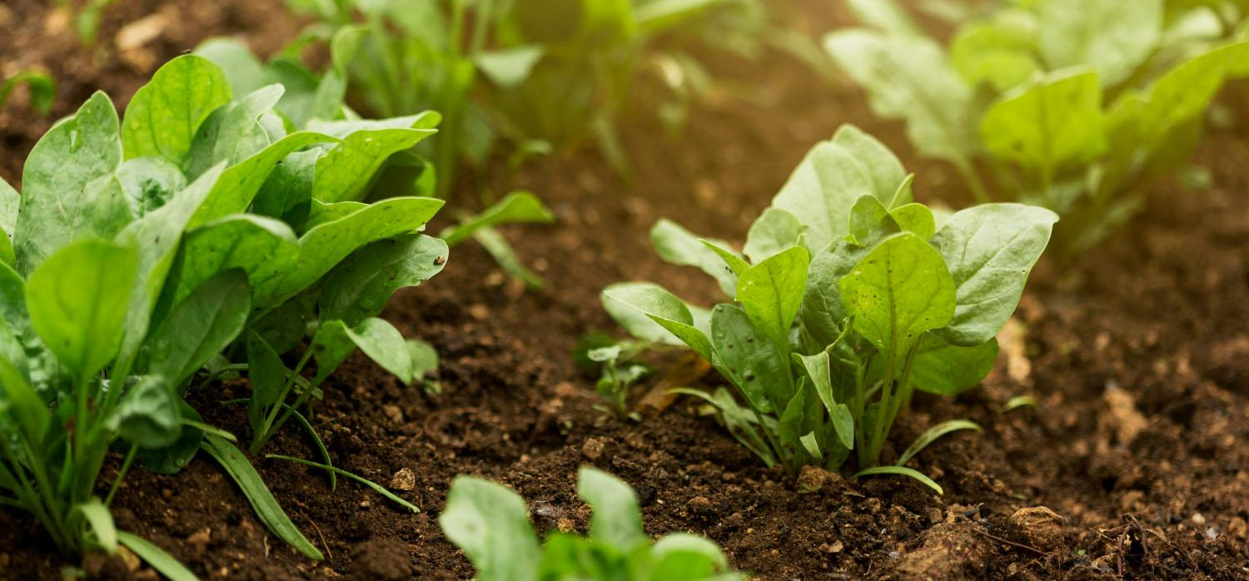
01
Introduction
Problem, Objectives, and Scope

Slide 4


The Challenge in Agriculture (Problem)
Farmers struggle to choose optimal crops due to
1
2
3
Limited soil and climate awareness
Overdependence on traditional practices
Reduced yields and increased resource wastage
Impact: Economic losses, unsustainable agriculture

Slide 5

The Objectives
What Are We Solving?
1
2
3
Identify the most suitable crops based on soil and climatic conditions
Provide data-driven recommendations for sustainable agriculture
Empower farmers with easy-to-use insights

Slide 6


System at a Glance (Scope)
Who are the target users?
Key Features:
ML based recommendations
scalability to diverse regions
Future Potential
SmartCrop

Slide 7
02
Methodology
How it works – Recommendation System Overview

Slide 8
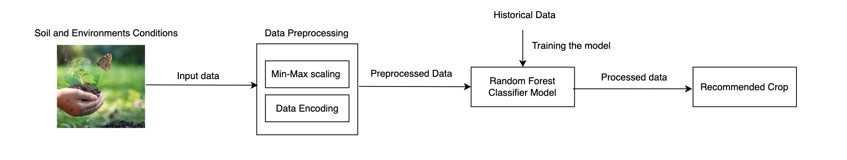
Recommendation System Overview

Slide 9
03
Approach
Machine Learning Approach Details

Slide 10

Machine Learning
A range of machine learning (classification) techniques were tested, including decision trees, random forests, support vector machines, and gradient boosting, etc. These were applied to construct predictive models. These models are trained on historical datasets and assessed using relevant performance metrics to guarantee accuracy and reliability.

Slide 11
Techniques
Splits data into subsets based on feature values, forming a tree-like structure.
Decision Tree
Applies Bayes' theorem with the assumption of feature independence.
Naive Bayes
Logistic Regression
Estimates probabilities using the logistic function.
Finds the optimal hyperplane that separates classes in high-dimensional space.
Support Vector Machine
K-Nearest Neighbors
Classifies based on the majority class among the k-nearest neighbors.

Slide 12
Cont.
Trained on a random part of the data.
Random forest
Similar to Random Forest, but with even more randomness.
Extra Trees
Bagging
Trained on a random sample of the data.
Models are built sequentially
Gradient Boosting
AdaBoost
Weak models are combined to create a strong one

Slide 13
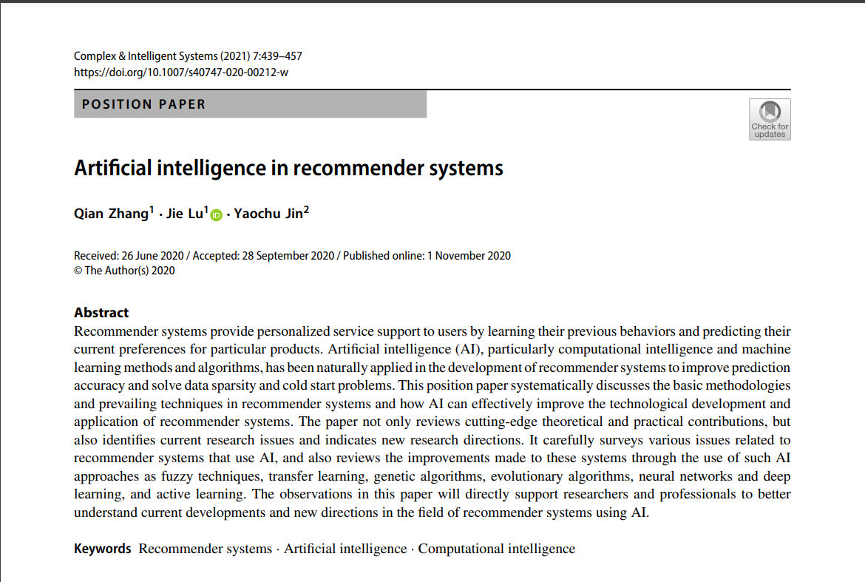
04
Linking AI in Recommender Systems to Our Project
How does the research align with our crop recommendation system?

Slide 14

Introduction to the Paper
Paper Title
Paper Authors
Published in
Artificial Intelligence in Recommender Systems
Qian Zhang, Jie Lu, Yaochu Jin
Complex & Intelligent Systems (2021)
DOI: 10.1007/s40747-020-00212-w
"This paper provided the theoretical foundation for designing our AI-driven crop recommendation system by emphasizing content-based approaches, machine learning robustness, and scalability."

Slide 15
How It Influences Our Project Key Concept Adopted
Content-Based Filtering
Machine Learning Models
Scalability
Used soil, climate, and crop data to create personalized crop recommendations
Inspired by the paper's emphasis on robust models
Addressed by integrating region-specific datasets with plans for IoT-based data collection

Slide 16
Comparison Table
 | Paper | Our Project
Core Approach | Content-based, collaborative, hybrid | Content-based; scalable to hybrid approaches
Data Focus | User preferences, ratings, browsing behavior | Soil pH, climate, and regional crop data
Challenges Addressed | Cold-start, scalability, data sparsity | Environmental variability, data integration

Slide 17
05
Conclusion
Final Result (Running the system)
Summarizing Key Points

Slide 18
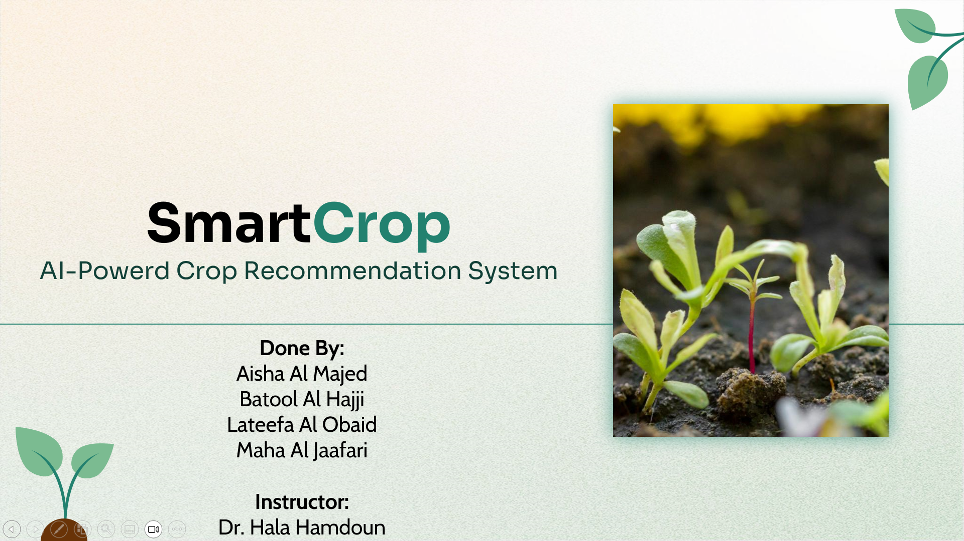
Thank You! for listening

